Slide 1

Warm-up
Finding Terms of a Sequence
Find the next four terms in the sequence.
1, 1, 2, 3, 5, 8, __, __, ___, ____,…
Write the explicit formula for the sequence.
  5, 13, 21, 29, 37, ___, ___, ___, ___,…
Write the explicit formula for the sequence.
800, 400, 200, 100, __, __, __, ___,…
Write the explicit formula for the sequence.
-27, 9, -3, 1, -1/3, __, __, __, __,...

Slide 2
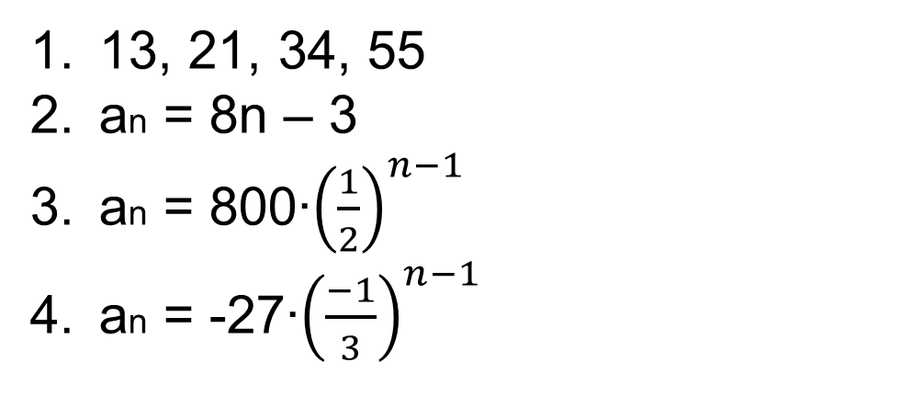
Answers

Slide 3
Lesson 8.3
Recursive Sequences
Objectives:
Find particular terms of sequence from the given general term.
2. Use recursion formulas to find subsequent terms.
3. Determine a formula from a sequence of numbers.

Slide 4
What is a
recursive sequence?
Definition:
A recursive sequence is the process in which each step of a pattern is dependent on the step or steps before it.

Slide 5
Recursion Formulas
A recursion formula defines the nth term of a sequence as a function of the previous term. If the first term of a sequence is known, then the recursion formula can be used to determine the remaining terms.

Slide 6







Sequence and Terms
Let’s look at the following sequence
n²
Do you know what the rule is for the sequence?
1,
4,
9,
16,
25,
36,
49,
…,
The letter a with a subscript is used to represent function values of a sequence.
The subscripts identify the location of a term.

Slide 7
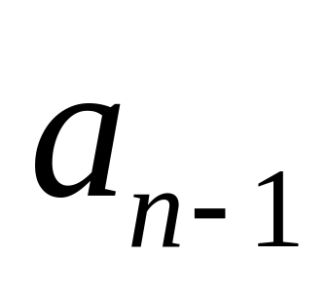
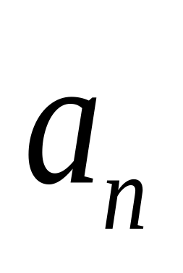
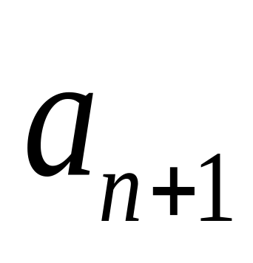
How to read the subscripts:
a term in the sequence
the prior
term
the next term

Slide 8
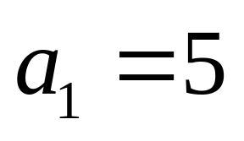
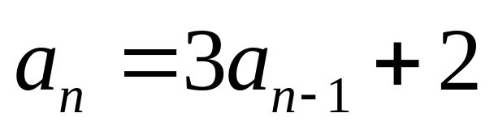
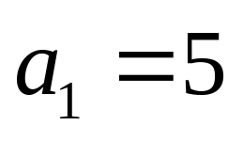

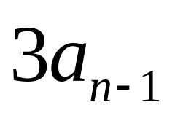
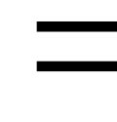
Ex. 1: Find the first four terms of the sequence:
General Term
Let’s be sure we understand what is given
+ 2
is
Each term after the first
3 times the previous term
Plus 2
The first term is 5

Slide 9

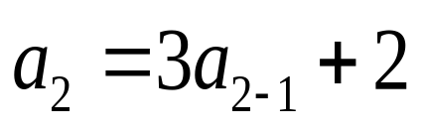
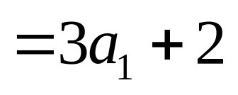
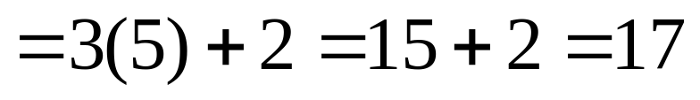
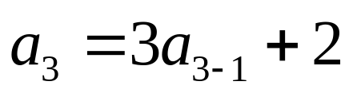
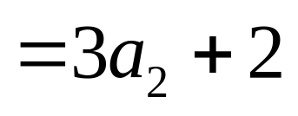
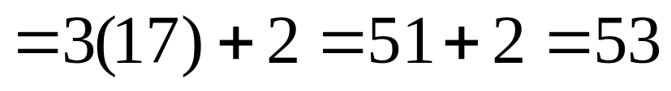


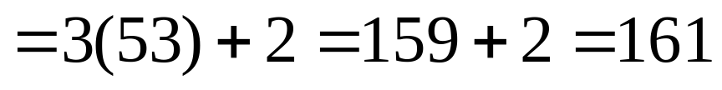
Continued…
Ex. 1: Find the first four terms of the sequence:
Start with general term for n>1
n=1
given
n=2
n=3
n=4
Answer = 5, 17, 53, 161

Slide 10
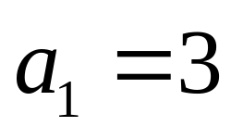
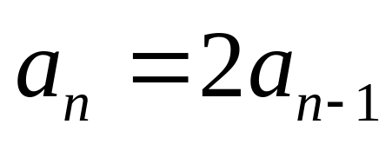
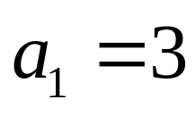
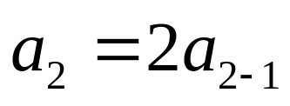
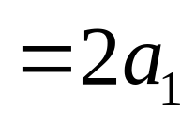
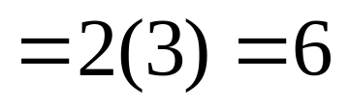
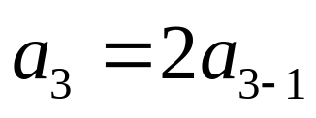
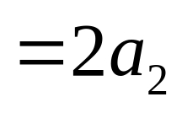
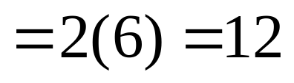
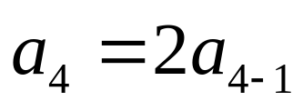
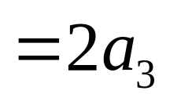
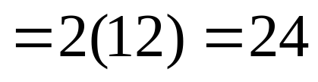
Your turn:
Ex 2: Find the next four terms of the sequence.
Start with general term for n>1
n=1
given
n=2
n=3
n=4
Answer = 3, 6, 12, 24

Slide 11
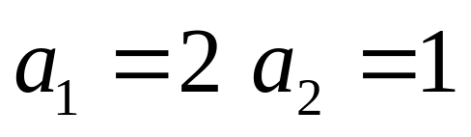
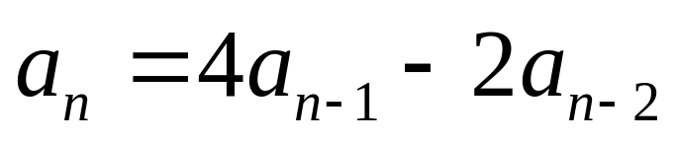
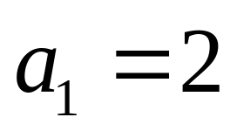
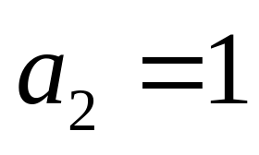

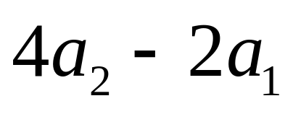

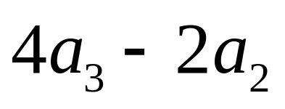

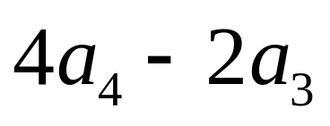
Try another…
n=1
given
given
n=2
=
4 – 4 = 0
n=3
=
0 – 2 = -2
n=4
n=5
=
-8 – 0 = -8
Answer = 2, 1, 0, -2, -8

Slide 12
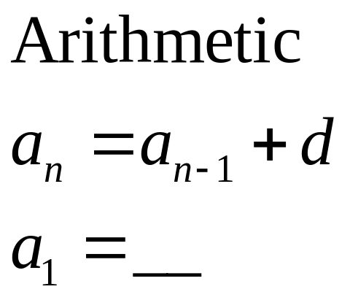
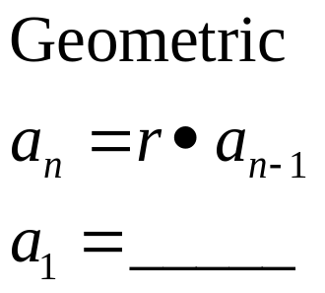
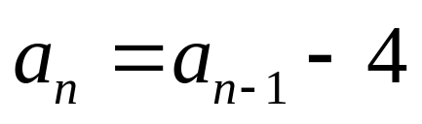
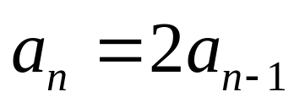
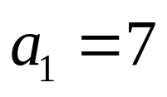

Your turn
Write a recursive formula for the sequences below.
Step 1 : Determine if it is arithmetic or geometric.
Step 2 : Plug in to either the geometric or arithmetic recursive formula.
Step 3 : Make sure you tell us what a₁ is equal to.
Ex. 3
7, 3, -1, -5, -9, …
Ex. 4
3, 6, 12, 24, 48, …
The common difference = -4
The first term = 3
The common ratio = 2
The first term = 7

Slide 13
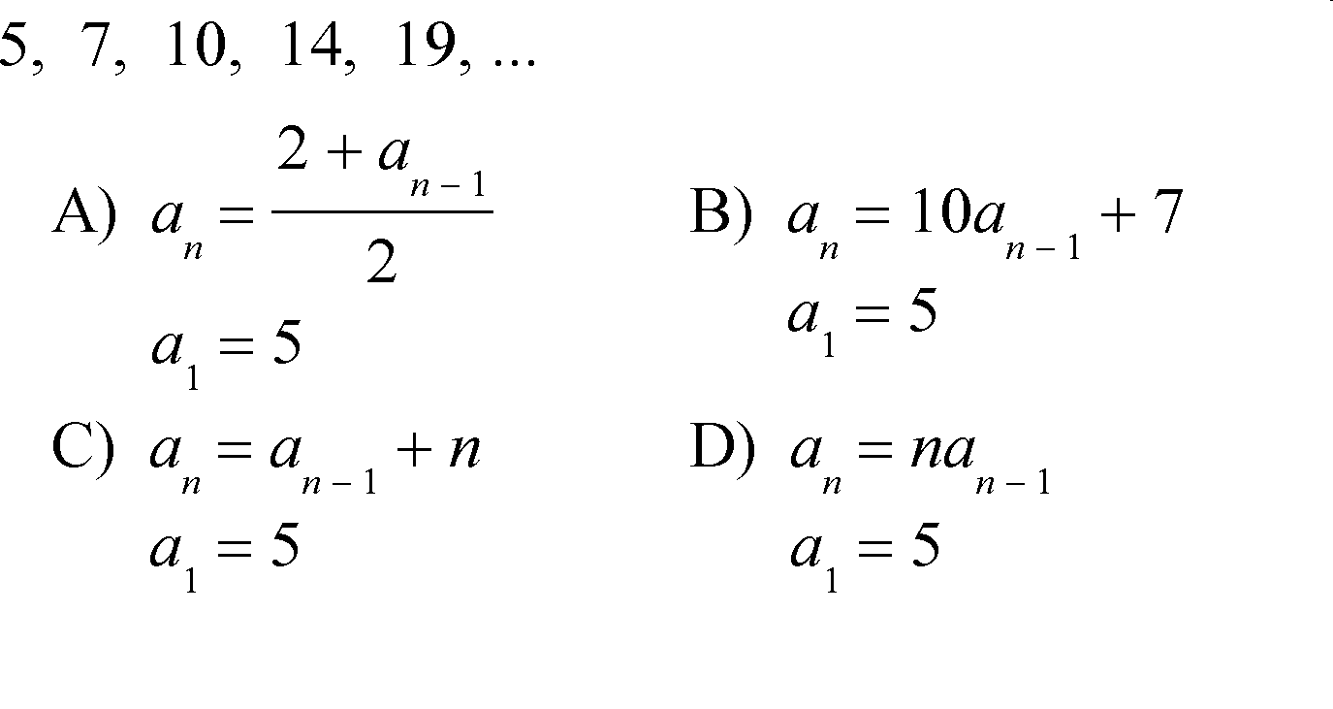
Last Example…
Choose the recursive formula for the given sequence.
Answer = C

Slide 14
Summary:
What is a recursive sequence?
Homework:
Worksheet 8.3 and quest review

